Slide 1
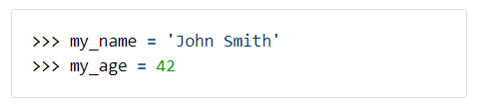
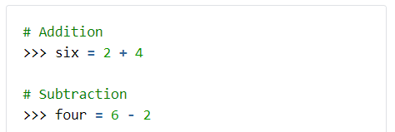
Part 1: Understanding Basic Python
Recap
You should already know this, but as a reminder:
How you assign variables
How you perform operations (such as arithmetic)

Slide 2

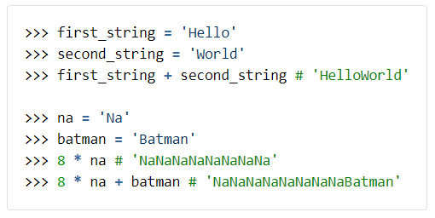
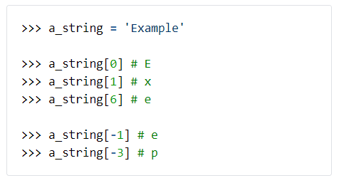
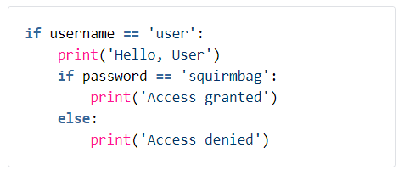
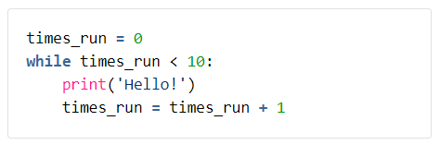
Basic Data Types, with operations allowed on each:
Different types of flow in Python:

Slide 3
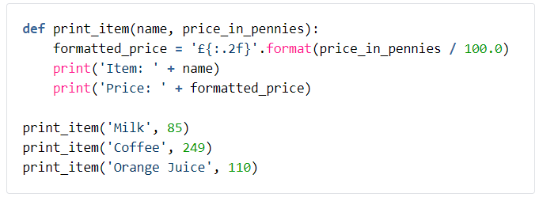
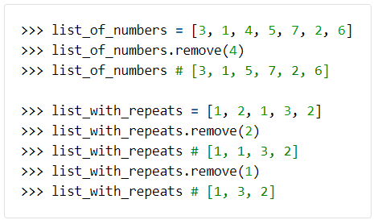
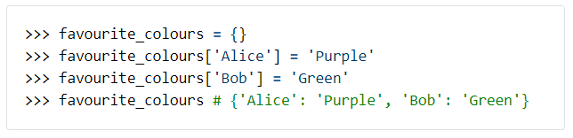
Functions Definitions & Usages:
Complex Data Types (Such as Lists & Dictionaries):

Slide 4
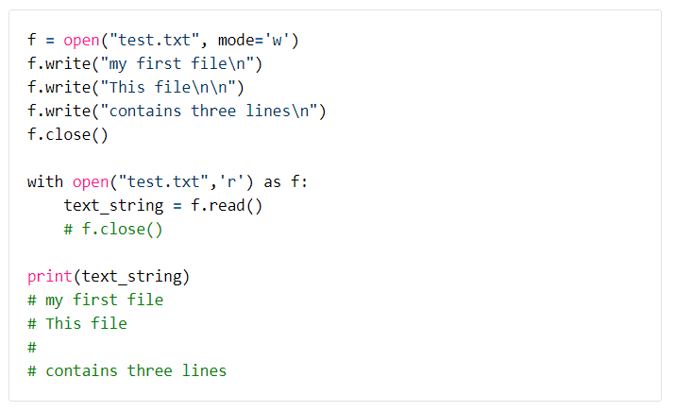
Part 1: New Concepts
Basic File Operations
Python provides various built-in functions for handling reading/writing of files:
Notes:
Read/write modes (incl ‘a’ mode)
Mention other options like encoding
Explain the usage of the with keyword (context manager + __enter__ & __exit__ magic methods)

Slide 5
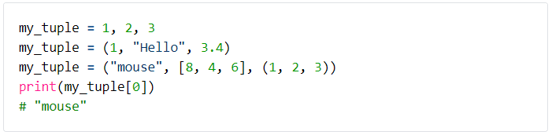
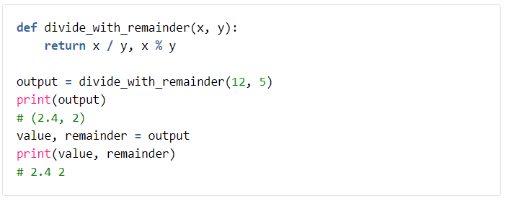
Tuples
Creation:
Can be used to return multiple values from functions:
Notes:
Compare to lists (not many differences on the surface
Mention / & // differences
Destructuring
Use as keys in dictionaries

Slide 6

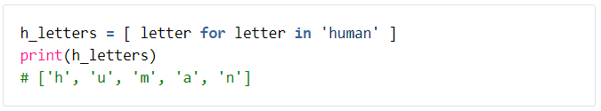
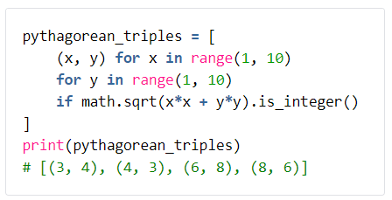
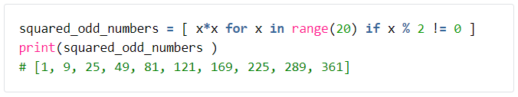
List Comprehensions In Python
Format:
Simple Example:
More Complex Examples:
Notes:
Mention dictionary comprehensions are a thing
Nesting list comprehensions
Multiple fors (zips and flattens)
Maybe mention assignment expressions (kinda gets you aggregates)

Slide 7
Part 1: Exercise
The Goal
Build a python script that can process a file with a list of instructions:
goto 4
replace 1 2
remove 3
goto 2
goto calc x 3 5
replace 6 10

Slide 8
Step 1:
Write a basic Python "calculator".
It should accept 3 pieces of input from the user: a string that's one of "x", "+", "-", or "/" (an operation), an integer (parameter A), and another integer (parameter B).
It should then emit the result of performing the operation on A and B.
For example, if your application asks the user for an operation and 2 numbers, and the user enters "+", "1", "2", then the application should output "3".
If the user supplied "/", "5", "2", the application should output "2.5".
If the user supplied "x", "5", "0", the application should output 0.

Slide 9
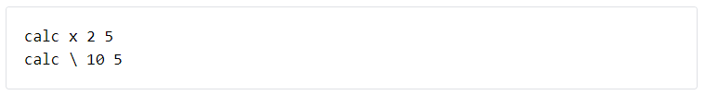
Step 2:
Next process the following file: Link
Each line contains a calculation statements prefixed by "calc":
Compute the value of each line using the code from step 1
Add up the results from all the lines and send the results to the trainer
Hint 1: For reading the lines from the file you may want to use file.read().splitlines()
to build a list of lines.
Hint 2: you may want to use string.split() to break up the parts of each calc line.

Slide 10


Step 3:
Next navigate the following file: Link
This has goto statements like the following
This means go to line 27 in the file and read the statement there. Please note that calc and goto statements can be combined like so:
This is equivalent to goto 3.
For simplicity assume that we cannot nest calc statements, decimals are rounded down and out of bounds gotos (i.e. invalid line numbers) do not occur.

Slide 11
Step 3 (continued):
Starting from line 1, use the rules above to navigate the document, stopping when you've hit a statement you’ve seen once before (they are allowed to be from different lines!).
When finished please send the statement and line number the code has stopped on to a tutor.

Slide 12
Step 4:
Finally navigate the following file: Link
This has some additional statements.
The goal is to process the file, starting from line 1, stopping when you’ve hit a statement you’ve seen before or manage to jump outside the file by a goto.
When finished, please send the line number & statement to the trainer to confirm.

Slide 13


Step 4 (Continued):
Additional Statements:
Remove line {line_number} from the file (if the line number does not exist do nothing) and then
Read the next instruction after this remove statement
Replace line {line_number_1} with line {line_number_2} (if either line number does not exist do nothing) and then
Read the next instruction after this statement

